Slide 1
SPRING SECURITY
Guide different users with different authorities to different webpages.
Integrate Login DAO into CustomUserDetails to load user from the Database via Hibernate.
Using @Transactional to declare a transactional method: loadUserByUsername()
loginSuccessAuthenticationHandler:
onAuthenticationSuccess()
Notes:
LoginSuccessAuthenticationHandler

Slide 2
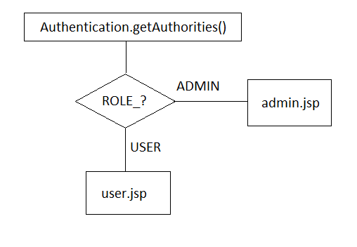
SPRING SECURITY
Guide different user with different authorities to different webpages.
Notes:
LoginSuccessAuthenticationHandler

Slide 3

MAIL SERVICE
Send an email to confirm that the user is registered successfully.
Two classes:
private JavaMailSender mailSender;
private SimpleMailMessage simpleMailMessage;
One .xml file:

Slide 4
